Slide 1
Natural Language Processing
Lab 3
Text Preprocessing- Stemming, Lemmatization, POS Tagging

Slide 2




www.tuf.edu.pk
unioffaisalabad
Objectives:
Understand stemming using different algorithms
Implement lemmatization.
Implement POS tagging.

Slide 3
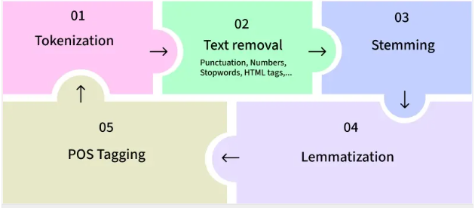
www.tuf.edu.pk
unioffaisalabad
Text Preprocessing in NLP
Text processing involves cleaning and preparing raw text data for further analysis.

Slide 4
www.tuf.edu.pk
unioffaisalabad
Stemming:
Stemming is an important text-processing technique that reduces words to their base or root form by removing prefixes and suffixes. .

Slide 5
www.tuf.edu.pk
unioffaisalabad
1. Installing the Required Libraries:
!pip install nltk spacy
pip is Python’s package manager.
nltk → Natural Language Toolkit, used for tokenization, stemming, lemmatization, and POS tagging.
spacy → A popular NLP library known for speed and efficiency, used for lemmatization and POS tagging.

Slide 6
www.tuf.edu.pk
unioffaisalabad
2. Downloading SpaCy’s English Language Model:
!python -m spacy download en_core_web_sm
-m spacy runs SpaCy as a module.
download en_core_web_sm downloads a small English model that SpaCy uses for:
Tokenization
POS tagging
Lemmatization
Without this model, SpaCy can’t process English text properly.

Slide 7
www.tuf.edu.pk
unioffaisalabad
3. Downloading NLTK Datasets:
import nltk
nltk.download('punkt')
nltk.download('wordnet')
nltk.download('averaged_perceptron_tagger’)

Slide 8
www.tuf.edu.pk
unioffaisalabad
1. Porter's Stemmer
from nltk.stem import PorterStemmer
from nltk.tokenize import word_tokenize
ps = PorterStemmer()
text = "Studies studying cried cries flying flies running runs happiness happily"
words = word_tokenize(text)
print("Porter Stemmer:")
print([ps.stem(w) for w in words])

Slide 9
www.tuf.edu.pk
unioffaisalabad
2. Snowball Stemmer
from nltk.stem import SnowballStemmer
from nltk.tokenize import word_tokenize
ss = SnowballStemmer("english")
text = "Connections connected connecting fair fairer fairest easily easiest studies studying cries cried"
words = word_tokenize(text)
print("Snowball Stemmer:")
print([ss.stem(w) for w in words])

Slide 10
www.tuf.edu.pk
unioffaisalabad
Lemmatization with NLTK:
from nltk.stem import WordNetLemmatizer
from nltk.tokenize import word_tokenize
text = "Studies studying cries cried running runs"
words = word_tokenize(text)
lemmatizer = WordNetLemmatizer()
print([lemmatizer.lemmatize(w) for w in words]) # Default noun assumption

Slide 11
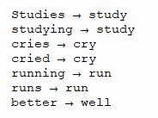
www.tuf.edu.pk
unioffaisalabad
Lemmatization with SpaCy:
import nltk
nltk.download('averaged_perceptron_tagger’)
import spacy
nlp = spacy.load("en_core_web_sm")
doc = nlp("Studies studying cries cried running runs better")
for token in doc:
print(token.text, "→", token.lemma_)

Slide 12
www.tuf.edu.pk
unioffaisalabad
POS Tagging with NLTK:
from nltk.tokenize import word_tokenize
import nltk
# Download required resources
nltk.download('punkt')
nltk.download('averaged_perceptron_tagger_eng')
# Sentence for POS tagging
sentence = "The quick brown fox jumps over the lazy dog"
words = word_tokenize(sentence)
# Perform POS tagging
pos_tags = nltk.pos_tag(words, tagset=None, lang='eng')
print(pos_tags)

Slide 13
www.tuf.edu.pk
unioffaisalabad
POS Tagging with NLTK:
from nltk.tokenize import word_tokenize
import nltk
# Download required resources
nltk.download('punkt')
nltk.download('averaged_perceptron_tagger_eng')
nltk.download('universal_tagset')
# Sentence for POS tagging
sentence = "The quick brown fox jumps over the lazy dog"
words = word_tokenize(sentence)
# Perform POS tagging
pos_tags = nltk.pos_tag(words, tagset=‘universal’, lang='eng')
print(pos_tags)

Slide 14
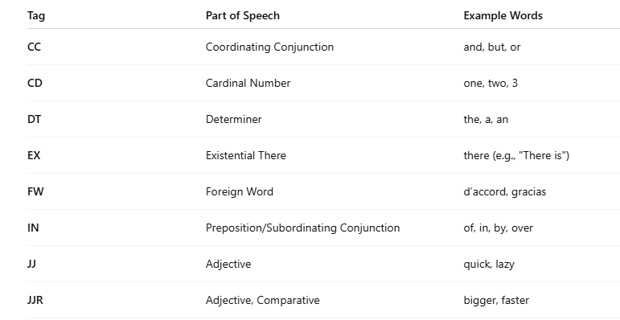
www.tuf.edu.pk
unioffaisalabad
Common POS Tags In NLTK:

Slide 15
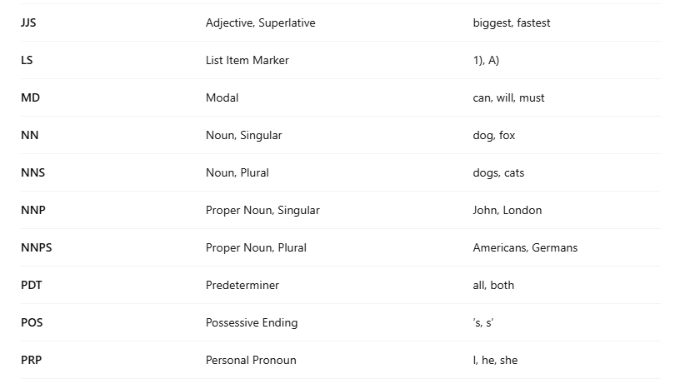
www.tuf.edu.pk
unioffaisalabad
Common POS Tags In NLTK:

Slide 16
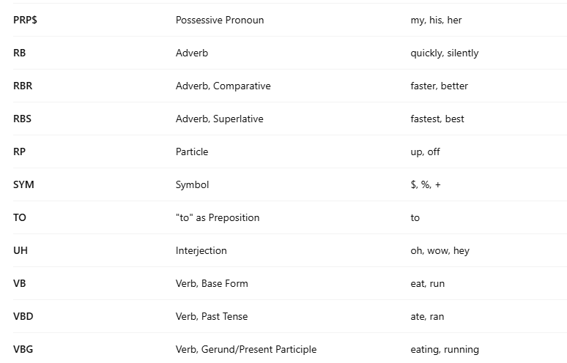
www.tuf.edu.pk
unioffaisalabad
Common POS Tags In NLTK:

Slide 17
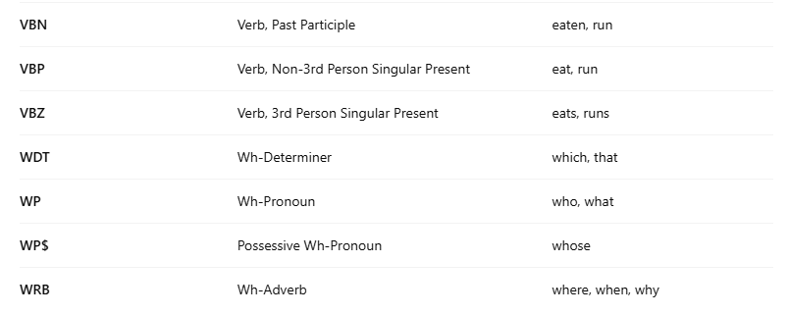
www.tuf.edu.pk
unioffaisalabad
Common POS Tags In NLTK:

Slide 18
www.tuf.edu.pk
unioffaisalabad
Home Task:
Mini Project
Take a paragraph from news or a blog post.
Perform:
Word Tokenization
Lemmatization
POS Tagging
Write 4-5 lines on how these preprocessing steps help in text analysis.

Slide 19
THANK YOU

